Slide 1

Default Risk
STEVEN L TRUONG
Friday, 05/14/2021

Slide 2
Motivation
Can we get accepted to the loan that we want when applying?

Slide 3

Motivation

Slide 4
Notes:
Home Credit is the international banking institution and they want to leverage the power of data science and machine learning to speed up their application process.

Slide 5
The Bank
Determine if potential clients are capable of repayment to prevent losing money on bad credit clients.
Notes:
Home Credit is the international banking institution and they want to leverage the power of data science and machine learning to speed up their application process.

Slide 6
The Bank
Applicants
Determine if potential clients are capable of repayment to prevent losing money on bad credit clients.
Ensure that people who are capable of repayment are not rejected and help people to achieve their dreams.
Notes:
Home Credit is the international banking institution and they want to leverage the power of data science and machine learning to speed up their application process.

Slide 7
Data and tools
Data
Language
Provided by Home Credit through Kaggle.
Python
Modeling
DataViz
Scikit-learn, xgboost, lightGBM, pandas, numpy.
Matplotlib, seaborn

Slide 8

Exploratory data analysis (EDA)

Slide 9
EDA and insights

Slide 10
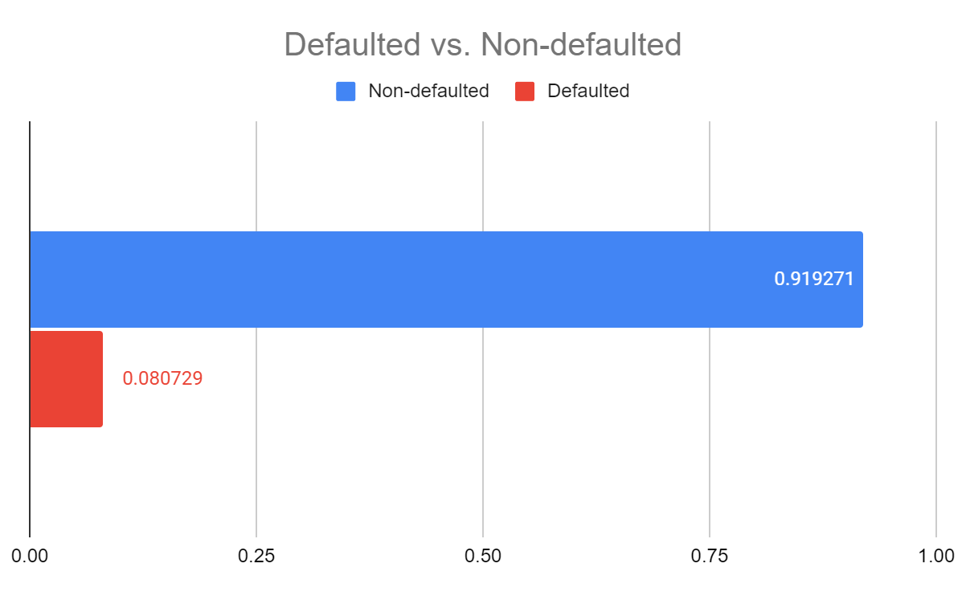
EDA and insights
91.9 %
NON-defaulted
Accounts that essentially have good credit.
8.1 %
Defaulted
People that have poor credit or non-existent credit histories.

Slide 11
EDA and insights
91.9 %
NON-defaulted
Accounts that essentially have good credit.
8.1 %
Defaulted
People that have poor credit or non-existent credit histories.
This is an imbalance class problem. The ratio is roughly 11:1
Notes:
Intuitively, age and income could be the major impact on the application results. Let’s explore more on these features.

Slide 12
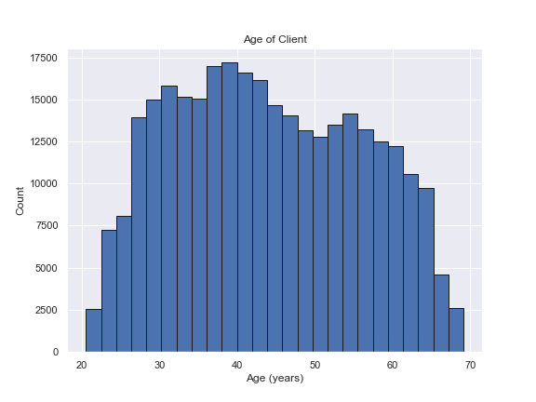
EDA and insights

Slide 13
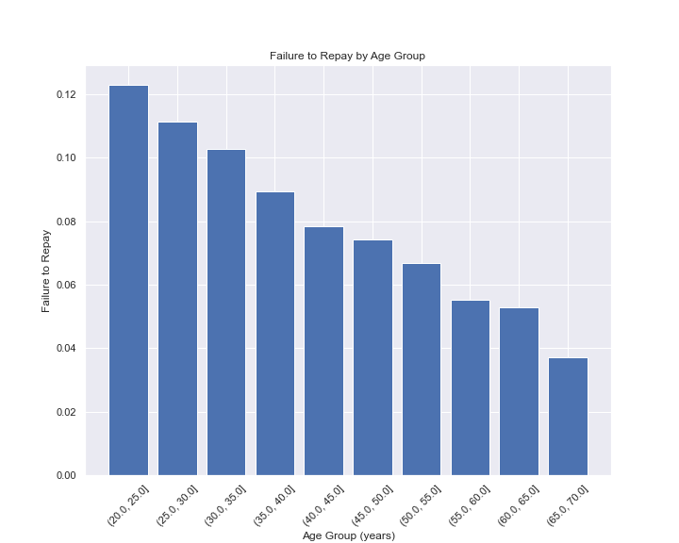
EDA and insights
The younger the client, the more likely to get defaulted.

Slide 14
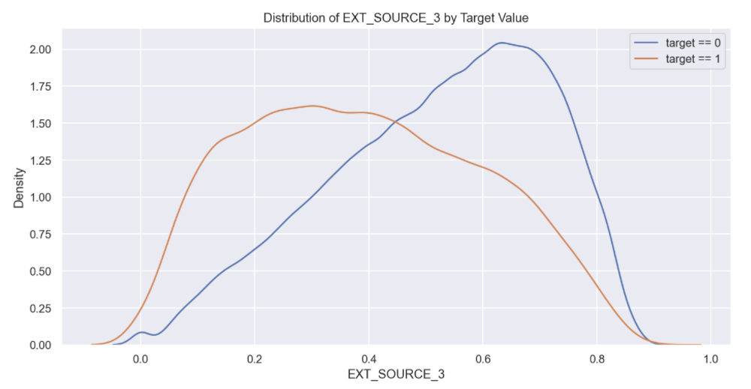
EDA and insights
External source of income displays the difference between the values of the target. Hence there is some relationship to the likelihood of an applicant to repay a loan.

Slide 15

Let’s build some models
Use the power of data science and machine learning.

Slide 16
Models comparison (ROC AUC)

Slide 17
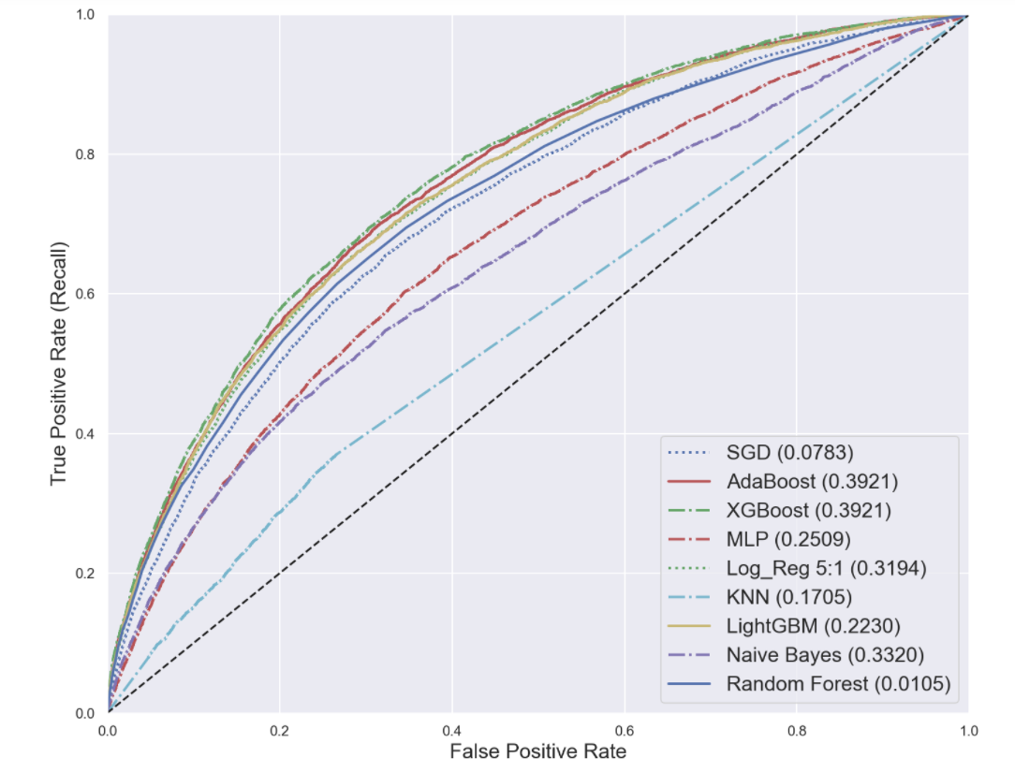
Models comparison (ROC AUC)

Slide 18

Models comparison (ROC AUC)
XGBoost wins.
(GBT on steroid)

Slide 19

Models comparison (ROC AUC)
XGBoost wins.
(GBT on steroid)

Slide 20
Models comparison (F2 Score)

Slide 21
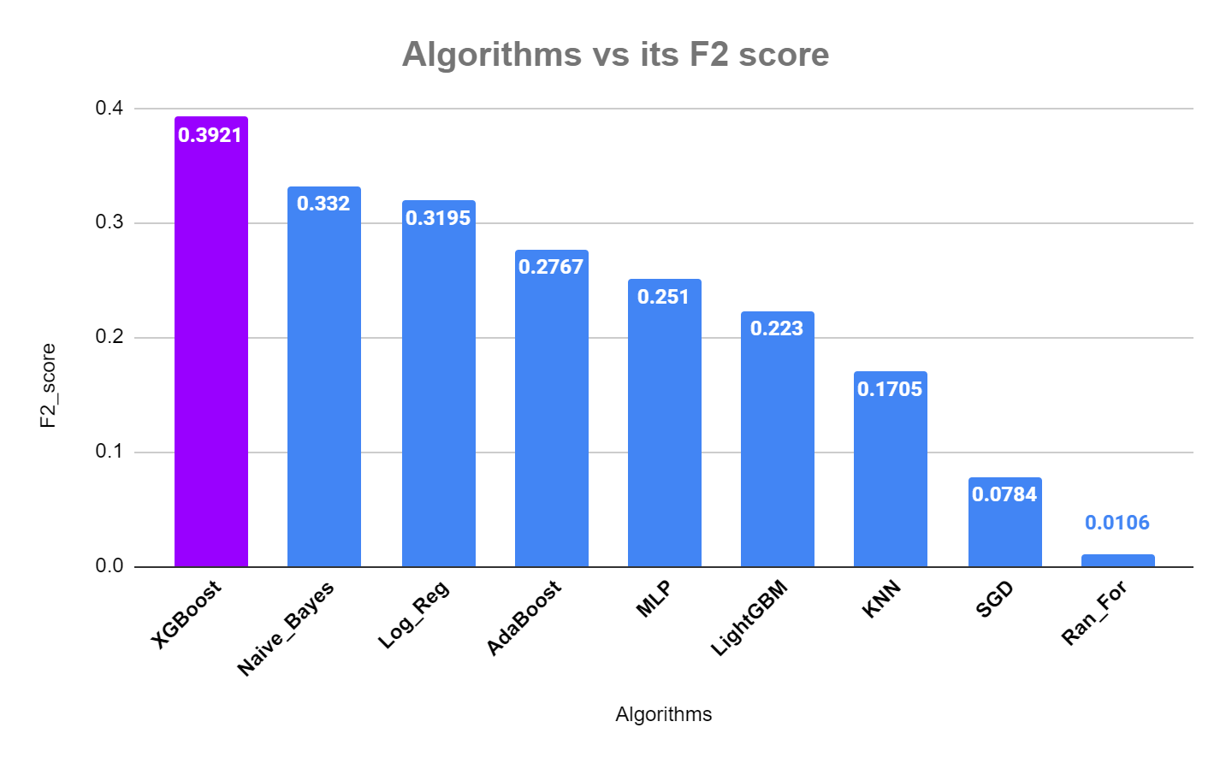
Models comparison (F2 Score)

Slide 22
Models comparison (F2 Score)
Metrics chosen: F_beta with beta = 2
Again, our good buddy XGBoost wins.

Slide 23

Model optimizaton
Now we have our chosen model, let’s tune and improve XGBoost.

Slide 24
Optimized XGBoost Model

Slide 25
Optimized XGBoost Model
Train Set
F2 Score
0.463
ROC AUC
0.804

Slide 26
Optimized XGBoost Model
Train Set
Test Set
F2 Score
F2 Score
0.463
0.432
ROC AUC
ROC AUC
0.804
0.768

Slide 27
Results

Slide 28
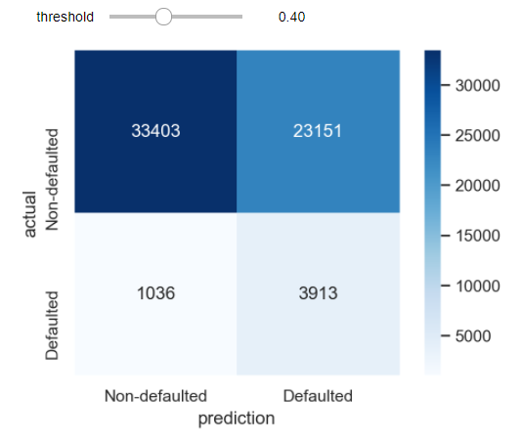
Results
We lean a little bit towards recall (not too strict on precision either)

Slide 29
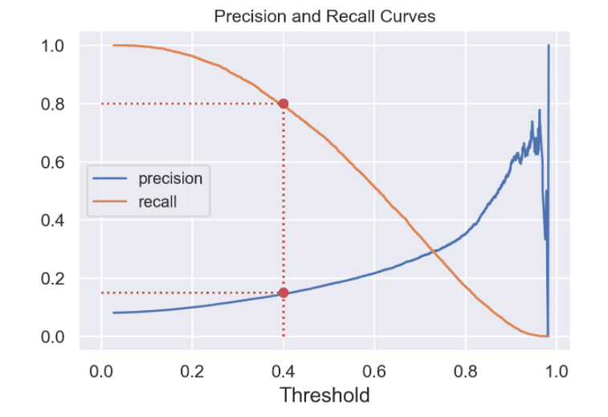
Results
We lean a little bit towards recall (not too strict on precision either)

Slide 30
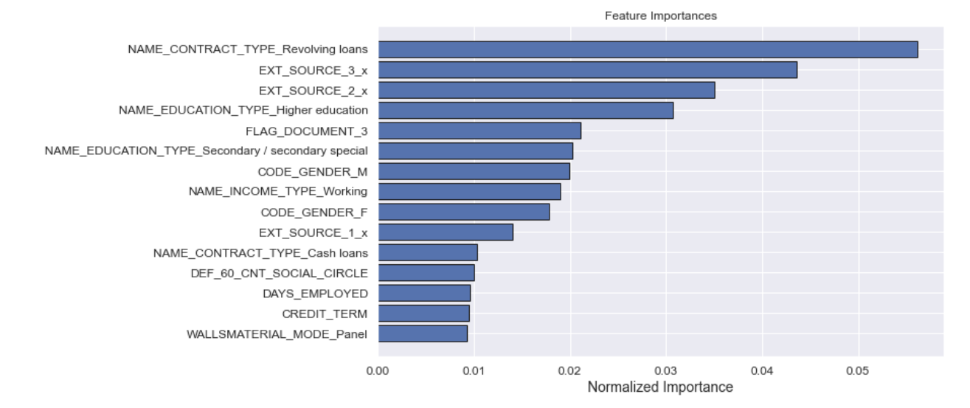
Features importance
Mainly external income sources, education, and type of loans determine the decision.

Slide 31
Recap

Slide 32
Recap
EDA/DataViz
Gather, clean, and explore data

Slide 33

Recap
Interactive features/ categorical features
EDA/DataViz
Feature Engineer
Gather, clean, and explore data

Slide 34

Recap
Interactive features/ categorical features
EDA/DataViz
Feature Engineer
Model seletion
Gather, clean, and explore data
Build, compare, and choose the best model

Slide 35
Recap
Interactive features/ categorical features
GridSearchCV, hyperparam tuning
EDA/DataViz
Feature Engineer
Model seletion
Optimization/ Deployment
Gather, clean, and explore data
Build, compare, and choose the best model

Slide 36
Future Work
Data
Algorithm
Deployment
Incorporate multiple datasets
Do better on XGBoost and LightGBM
Build interactive app and deploy to streamlit/AWS

Slide 37

How to confuse machine learning

Slide 38
Thank you
Steven L Truong
Questions?
Please reach out to me at https://www.linkedin.com/in/luongtruong77/

Slide 39
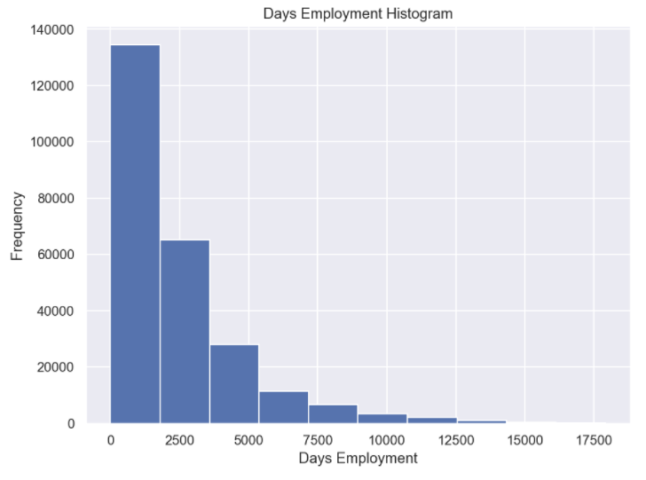
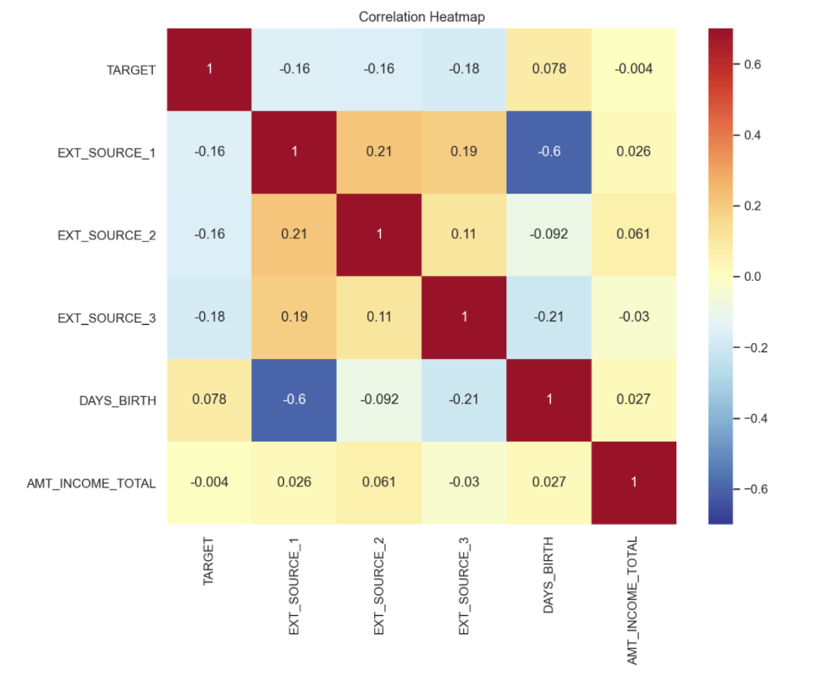
Appendix

Slide 40
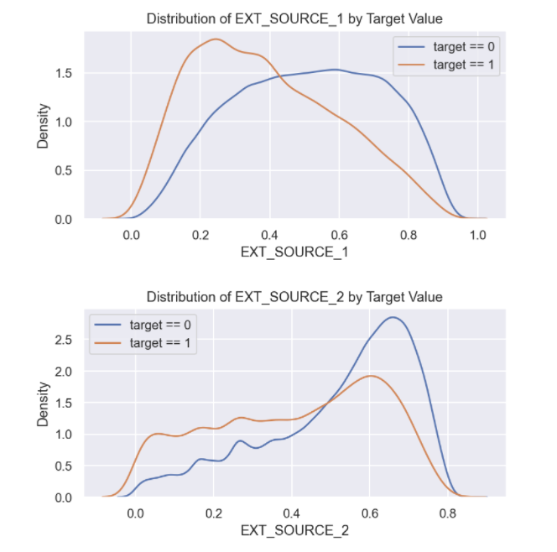
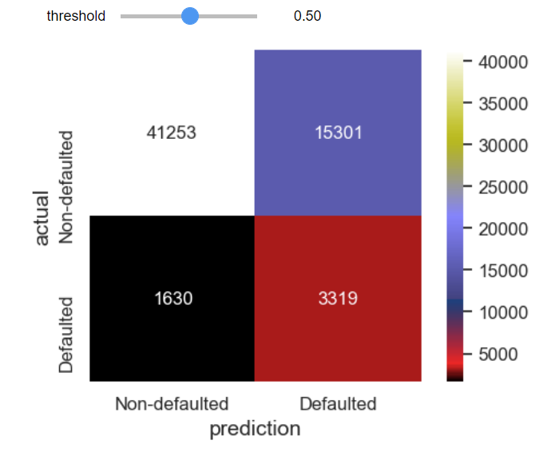
Appendix

